Slide 1
GIIA Masterclass - Insurance Act 2015 Challenges & Implications for the Captive Industry Raising Standards in the Captive arena Bruce Hepburn, CEO Malcolm Cutts-Watson, Senior Advisor David Hertzell, Senior Advisor & former Law Commissioner Guernsey, 18th May 2016

Slide 2
IA 2015 – Implications for the Captive industry
Agenda
Introduction
Insurance Act 2015
Implementation challenges
Captive implications and risks
Q&A

Slide 3
IA 2015 – Implications for the Captive industry
Quotes from parliamentary debate on law reform
Andrea Leadsom MP, Economic Secretary to the Treasury, stated:
“The existing law was developed to protect insurers in a fledgling insurance industry. It is insurer-friendly and gives wide-ranging opportunities to refuse liability for claims where a policyholder breaches an obligation even when that seems completely out of proportion to any wrong done by them. That causes disputes between insurers and policyholders, meaning delay, expense and uncertainty. It can significantly hinder UK businesses and wider communities”.
“… Policyholders cannot always predict whether insurers will pay out or rely on technical legal arguments to deny claims. If they cannot assess quality, policyholders will buy on price alone, which could reduce the quality of insurance products available in the market.” …
“… Modern insurance contracts are full of warranties, yet policyholders and brokers are often unaware of the harsh consequences of breaching them.”
Lord Newby, Government Deputy Chief Whip and HM Treasury stated:
[Marine Insurance Act of 1906] “Its main fault, from the modern perspective, is that it gives insurers many opportunities to refuse liability for claims, even when that seems completely out of proportion to any wrong done by the policyholder.”

Slide 4
IA 2015 – Implications for the Captive industry
Duty of Fair Presentation (1)
Question of substance and form
Insured must:
Disclose all “material circumstances” it knows or ought to know or, failing that,
Provide sufficient information to put underwriter on notice to ask further questions
Insured may not “data dump”
Insured knows what its senior management, persons arranging insurance (e.g. broker/risk manager/finance director/proprietor) know and ought to know what would reasonably have been revealed by reasonable search.

Slide 5
IA 2015 – Implications for the Captive industry
Duty of Fair Presentation (2)
Insured does not have to disclose a circumstance if insurer knows it, ought to know it or is presumed to know it. That means:
Insurer knows what is known to underwriters/agents - not senior management
Insurer ought to know what should have been passed on to underwriters or what it holds in its systems provided it is “readily available”
Insurer presumed to know common knowledge and what underwriters writing that class of business should know.

Slide 6
IA 2015 – Implications for the Captive industry
Insurer’s remedies
“Deliberate or reckless breach” – insurer can avoid policy and keep premium
All other breaches:
If the insurer would not have written the risk – avoid and return premium.
If the insurer would have imposed additional terms/additional limits – these are imposed from inception and/or
If the insurer would have charged a higher premium claim is reduced pro-rata (average)
NB. No “innocent non-disclosure”.

Slide 7
IA 2015 – Implications for the Captive industry
Warranties & similar terms
Basis clauses abolished – cannot contract out
Warranty becomes suspensive condition – cover is suspended but breach can be remedied and cover restored
Insurer cannot rely on warranty or other risk mitigation term if insured shows non-compliance “would not have increased the risk of the loss which actually occurred in the circumstances in which it occurred”
Does not apply to a term which defines risk as a whole.

Slide 8
IA 2015 – Implications for the Captive industry
Contracting out
Cannot contract out of basis clause provision or if policyholder is consumer (warranties/fraud) unless favourable to consumer
If a term places a business policyholder in a worse position then insurers must:
Take sufficient steps to bring term to policyholder’s attention; and
Ensure term is clear and unambiguous
Flexible test. More required for SME/direct sales than for broked or sophisticated market.

Slide 9
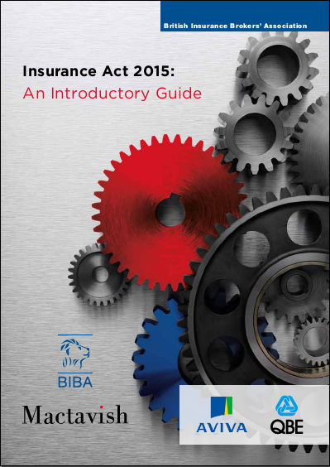
IA 2015 – Implications for the Captive industry
Insurance Act 2015 – Implementation Challenges
BIBA/Mactavish Guide: Part One (Introduction)
Critical summary of what the Act does
BIBA/Mactavish – Introductory Guide:
Explaining the key changes within the Act
Duty of Fair Presentation
Warranties & Conditions
Fraudulent Claims
Contracting Out
What insureds need to consider
Support brokers should seek from insurers
Broker toolkit

Slide 10
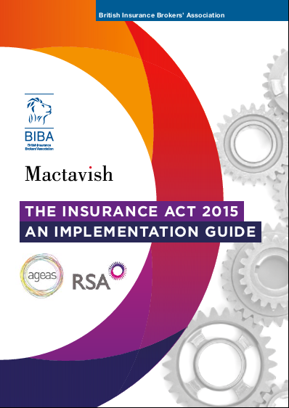
IA 2015 – Implications for the Captive industry
Insurance Act 2015 – Implementation Challenges
BIBA/Mactavish Guide: Part Two (Implementation)
Critical guidance on what each party needs to do
BIBA/Mactavish – Implementation Guide:
Challenges of implementation
Devil in the detail
Fair Presentation & Reasonable Search
Warranties & Conditions
Contracting Out
Implementation measures: a blueprint for customers, brokers and insurers
Broker toolkit updated

Slide 11
IA 2015 – Implications for the Captive industry
FERMA – Changes in UK Insurance Law
FERMA/Mactavish Introduction to the Insurance Act 2015 for European businesses
FERMA/Mactavish – IA 2015 Introduction:
Key aspects of the Act
The duty of fair presentation
Warranties and other conditions
Third parties rights and remedies for fraud
Contracting out
Key considerations for European businesses

Slide 12
IA 2015 – Implications for the Captive industry
Insurance Act 2015 – Dangers of oversimplification
First principles” legislation inevitably leaves detail that Courts must resolve over time. Litigation is inevitable (and arbitration prolongs the uncertainty)
Clarification likely around, e.g. ‘senior management’, ‘reasonable search’, ‘reasonably accessible’, ‘ought to know’, ‘contracting out’ etc.
Major dangers of oversimplification - As the market gets to grips with IA 2015, it is awash with a range of commitments seeking to respond to, contain, or even avoid its challenges. These include:
Sign-off of existing disclosure as being adequate for “fair presentation”
Conditional waiver of average for SME segment
“In principle” commitments to abide by the Act, regardless of wording detail
‘Variant’ or ‘equivalent’ wordings which may often be unclear and/or conflict

Slide 13
IA 2015 – Implications for the Captive industry
Insurance Act 2015: Dangers of oversimplification
But this does not “solve” the problem and leaves many questions unanswered – to take just a tiny few:
What if FP ‘sign-off’ is later challenged by an insurer on the basis of an ‘unknown unknown’?
What if an insurer waives average but then applies a proportionate remedy instead?
What if ‘in principle’ IA agreement conflicts with the policy wording or wording is inconsistent?
What if advice to a client that existing disclosure is adequate later falls down on the basis of a procedural failing?
Real certainty under the Act can only be generated by:
Getting implementation steps right around fair presentation and placement
Properly understanding policy wording terms
Adopting a “professional” mind-set that follows the spirit as well as the letter of the Act

Slide 14
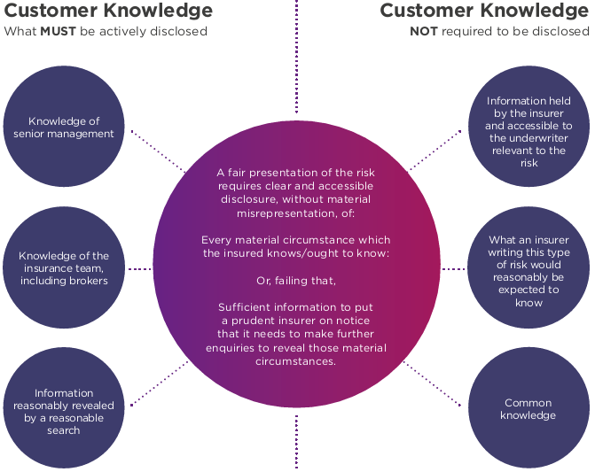
The Duty of Fair Presentation

Slide 15
Key Point 1 – Senior Management
“Senior management” is defined by as “those individuals who play significant roles in making decisions about how the insured’s activities are to be managed or organised”
Those key words “to be” are very significant. It may be that it is not management or organisation of the activities themselves that count - it is decisions as to how activities are “to be” managed or organised. That suggests a higher level of management
That may include influential angel investors, private equity investors, non-executives, and family members. It has been defined as a matter of influence to capture shadow directors

Slide 16
Key Point 2 – Controlling Mind or Will
The senior management definition is aimed at including the controlling mind or will or the organisation
If the board know (or any member of the board knows) material circumstances, these should be disclosed
It should be no excuse that the board concealed information from their risk manager or broker

Slide 17
Key Point 3 – Reasonable Search & 3rd Parties
Reasonable search potentially encompasses any third parties who hold information about the insured, whether or not they are involved in procuring the insured’s insurance. The limit depends on how far it is reasonable for the search to extend
Policyholders may therefore have to make enquiries of agents such as brokers, lawyers and technical advisors who may hold information relevant to the risk
Which agents should be included in the search will vary depending on the circumstances and the type of insurance. An insured’s solicitor may have information relevant to a professional indemnity policy but not a building and contents policy

Slide 18
Key Point 4 – Beneficiaries of Policies
The Act states that a reasonable search should include information available to the insured’s organisation or “held by any other person (such as the insured’s agent or a person for whom cover is provided by the contract of insurance)”
In some cases, particularly in a Directors’ and Officers’ insurance or similar liability context, or where a group of companies and contractor interest is being insured, this requirement may become very demanding if there are a large number of potential beneficiaries
We expect the Courts to apply caution by class of insurance

Slide 19
Key Point 5 – Terms Tending to Reduce Risk
The Act presents contracting parties and courts with a new challenge. They will have to determine whether a term concerns loss of a particular kind or loss at a particular time or location, or whether it defines the risk as a whole. If the latter then section 11 does not apply
If section 11 applies, the insurer cannot rely on non-compliance if the insured shows that it “could not have increased the risk of the loss which actually occurred in the circumstances in which it occurred.”

Slide 20
Key Point 6 – Post Loss Conditions Precedent
Despite the Act, there is still potential for “technical” defences
“Post loss” conditions precedent to liability requiring, for example, notification within specified periods are still enforceable
A technical breach of such conditions can still result in the loss of claims (e.g. notification outside the specified time limit, even if no prejudice is caused)

Slide 21
Key Point 7 – Contracting Out
Contracting out is intended to operate flexibly, depending on the circumstances of the insured: insurers will need to do more to bring a term to the attention of a small business, particularly if the business is buying online without a broker
It follows that if there is a broker, the insurer can do less to pass the test. If the broker has actual knowledge of a disadvantageous term (e.g. because it is in the insurer’s standard terms), this would be sufficient. The only question would be whether it is clear and unambiguous as to its effect

Slide 22
Key Point 8 – Contracting Out Example
An insurer writing “LMA 5260/5258” on a slip leaves the broker exposed to E&O if they don’t explain it in full to the customer
The Act doesn’t require the insurer to say that something is actually contracting out. And it isn’t obliged to explain to the customer, if it has explained to the broker
LMA 5258 – would mean that even if a warranty breach is rectified the policy remains invalid (contracts out of all s.10)
LMA 5260 – could mean that even an irrelevant breach of a warranty or condition precedent might invalidate the whole policy or avoid liability for a claim (contracts out of s.11)

Slide 23
Key Point 9 – Disclose Breaches of Conditions
Since, under the old law, a breach of warranty would discharge all insurer liability, disclosure of facts relating to a breach of warranty by the customer (as at the time of contracting) was generally not required.
The new Act makes warranties suspensory (i.e. the insurer is again liable once the breach is rectified, where the breach is capable of being rectified) which is obviously of benefit
However, facts relevant to the insured’s propensity to breach a warranty (or, indeed, any condition tending to mitigate risk) might now be material for the purpose of fair presentation. This would be a demanding departure from current practices

Slide 24
Key Point 10 – Data Dumping
The Act protects insurers from “data dumping”. However, brokers have no statutory protection. Brokers will need contractual protection to manage their potential duties to filter any “data dumping” presented to them by their policyholders (e.g. an e-mail with 50 attachments, or a download-link, sent days before renewal)
Who is responsible for filtering the relevant information?
Unless the broker’s contract deals with this issue, the broker may find that it is responsible for marshalling and presenting the “dumped data” into a clear and accessible form

Slide 25
Key Point 11 – Enterprise Act 2016
The Enterprise Act: an add-on to the IA 2015 now incepts 4.5.17
Critical benefit for policyholders arising from the ‘damages for late payment’ provision:
Damages available if the client business suffers or fails, if the insurer acts unreasonably in denying or delaying payment of a claim
However, constituent client obligations will challenge:
Have to mitigate loss, e.g. by raising other funding where viable
Must demonstrate that damages were foreseeable to the insurer at point of placement
Have to contemporaneously record where damages are incurred
Contracting out – any insurer caps on consequential damages will trigger obligations defined under the IA 2015
All present new E&O exposures

Slide 26
Key Point 13 – Enterprise Act 2016
Enterprise Act 2016: Mactavish led negotiation
Enterprise Act 2016:
Mactavish Negotiation
Damages for late payment legislation
Removed from IA 2015 but brought back in by the UK Government in the Enterprise Bill
Described as a line which insurers would not cross
Mactavish asked to negotiate industry agreement

Slide 27
Key Point 13 – Enterprise Act 2016
Enterprise Act 2016: Market agreement and significance
Enterprise Act 2016:
Mactavish Negotiation
Mactavish led the negotiation and engaged the top insurance QC in the country
Legislation amended with widespread market support and signatories
Landmark success for policyholders
Achieved Royal Assent on the 4th May 2016 and will come into force on 4th May 2017

Slide 28
IA 2015 – Implications for the Captive industry
Insurance Act 2015 – Captive concerns and risk factors
Reliable Act implementation is a complex challenge
Uniquely, captives have to deal with all of its components:
As customer when buying reinsurance
As insurer when dealing with client company, wordings, claims etc.
IA 2015 also shines a new light on some traditional captive concerns:
Broker clarity over the various roles of the captive, ensuring treatment as distinct from client company?
Adequacy of underwriting and claims procedures: could compliance with IA standards for insurers become a further component of demonstrating ‘substance’?
What is the disclosable knowledge of the captive as insurance customer?

Slide 29
IA 2015 – Implications for the Captive industry
Insurance Act 2015 – Captive concerns and risk factors
Act provides for simpler and fairer claims resolution – but increases focus on record-keeping, process & procedures (on all sides)
Several obvious risk factors for the unwary captive which could undermine “substance” of arrangement OR reliability of reinsurance:
The Act includes new explicit and implicit standards for keeping underwriting records and accessing information (which enable insurer remedies under the Act but also serve to define “proper” underwriting)
Bespoke wordings could prove unreliable if they fail to meet contracting out requirements back to back
Could a reinsurance presentation be deemed ‘unfair’ if unique captive-held information (such as sub-deductible claims analysis) is not passed on
Inadequate separation of captive roles by the broker may undermine captive validity – requiring clarity in practice and via broker service contracts

Slide 30
IA 2015 – Implications for the Captive industry
Insurance Act 2015 – example steps to aid compliance:
Captive as insurer:
Mitigating Captive Risk
Captive as customer:
Mitigating Captive Risk
Encourage the client company to improve underlying disclosure process
Ensure consistent captive access to the full set of underwriting information
Review existing policy wordings for Act compliance
Clarity over contracting out position: what is required & how is it explained?
Review broker contracts both as a risk-sharing mechanism and to clarify roles
Ensure underwriting file notes are complete and detailed
Awareness of potential unique disclosable knowledge (e.g. claims)
Develop captive-specific answers to some core questions around FP’:
- Who is captive ‘senior management’?
- Are there any external service providers
to the captive with relevant knowledge?
Start the process earlier in the first post Act cycle
Explicitly seek reinsurer feedback
Review wording alignment in light of potential “Act equivalent” variation

Slide 31
IA 2015 – Implications for the Captive industry
Insurance Act 2015 – How we can help?
Act compliance experts with a unique capability mix, Mactavish currently advise all parties & focus on improving standards
Unique position to assist captives: improving customer offer, reducing regulatory risk and protecting reinsurance reliability:
Assessment & design of a holistic plan for Captive compliance
Expert wording assistance to achieve consistency up the chain of cover
Building certainty around the “Fair Presentation” challenge – both as insurer and RI customer
Designing and negotiating broker service / TOBA changes to reflect shifting responsibilities
Claims governance: advice, negotiation and dispute resolution in the new insurance era

